Slide 1

Pathogens and immunity
By Wendy Chai
https://pediaa.com/difference-between-definitive-host-and-intermediate-host/
terms explained:
https://microbiologynote.com/host-pathogen-interaction/#:~:text=The%20term%20host%20is%20refers%20to%20those%20organisms,host%20body%2C%20weather%20it%20causes%20disease%20or%20not.

Slide 2
Content
Pathogens & transmissible diseases
Ways of transmission
Body defences
First & second infection
How do antibodies work
Active & Passive immunity
Vaccination
Control spread of transmissible diseases
Auto-immune disease - Type I diabetes

Slide 3
Key questions (presentations)
1. List 4 types of pathogens & some transmissible diseases they cause.
2. Ways of transmission
3. Body defenses: physical barrier, chemical barrier, immune cells
4. What is antigen? Antibody? How do antibody work?
5. Compare body responses to first-time & second-time infection.
6. How do vaccines work? (Vaccination)
7. Compare active and passive immunity, give examples.
8. How can we control spread of infectious diseases?
9. Auto-immune diseases: type I diabetes (cause, symptoms, treatments)

Slide 4
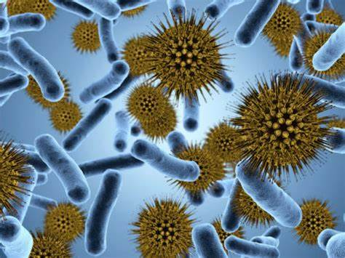
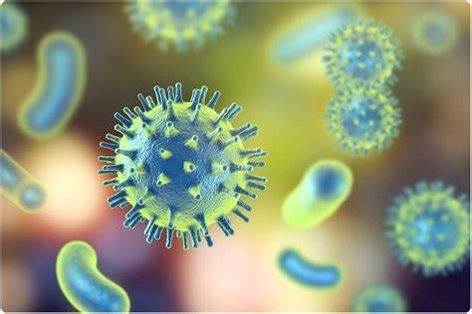
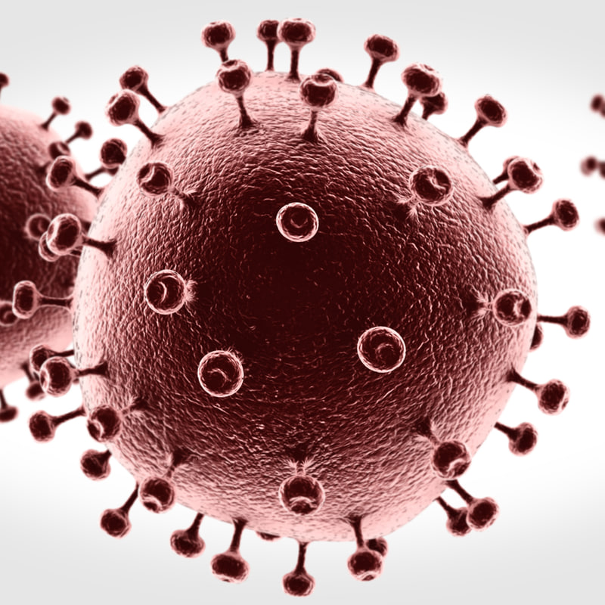
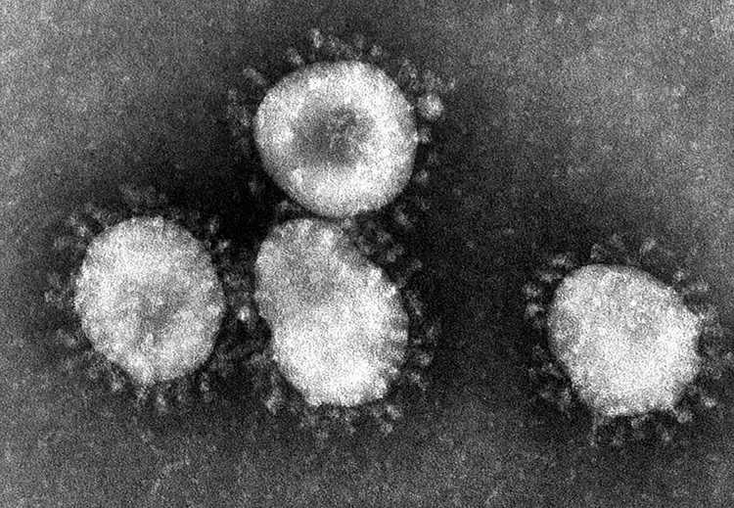
Pathogens
Disease-causing microorganism.
4 main types:
Virus
Bacteria
Fungi
Protoctist
(parasites)

Slide 5
Examples
Diseases
Tuberculosis (肺结核)
Cholera (霍乱)
AIDS
Cold and influenza
Malaria （疟疾）
Athlete’s foot (脚癣)
Poliomyelitis (polio) (脊髓灰质炎)
COVID-19 (old name “Novel coronavirus pneumonia, 新冠肺炎”)
Small pox
rabies
Pathogen
Bacteria
Bacteria
Virus (HIV)
Virus
Protoctist
Fungus
Virus
Virus (SARS-CoV-2/ COVID-19/ 2019-nCov)
Virus
virus
https://www.cdc.gov/malaria/about/disease.html
https://www.cdc.gov/malaria/about/biology/index.html
Notes:
Incubation period: In medicine, the time from the moment of exposure to an infectious agent until signs and symptoms of the disease appear.

Slide 6
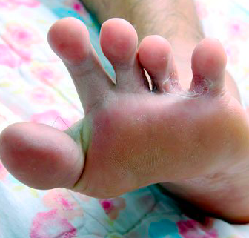
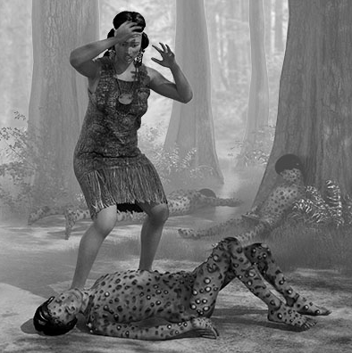
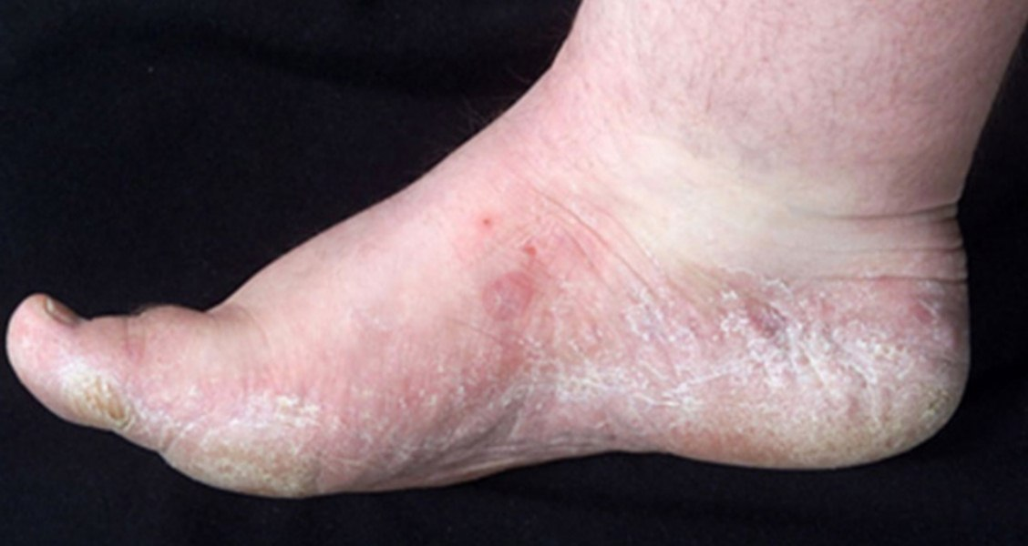
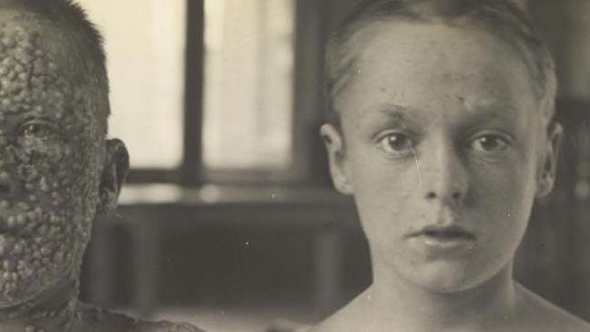
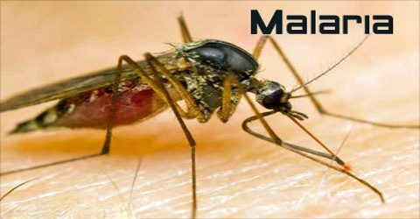
Athlete's foot is a term given to almost any inflammatory skin disease that affects the sole of the foot and the skin between the toes.
Small pox

Slide 7
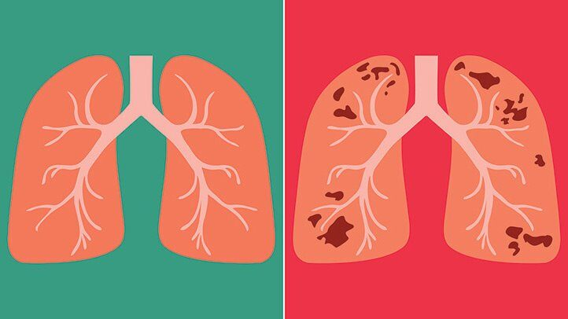
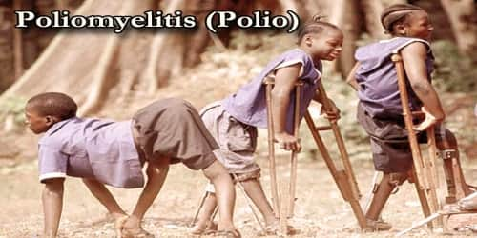
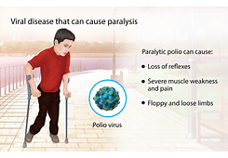
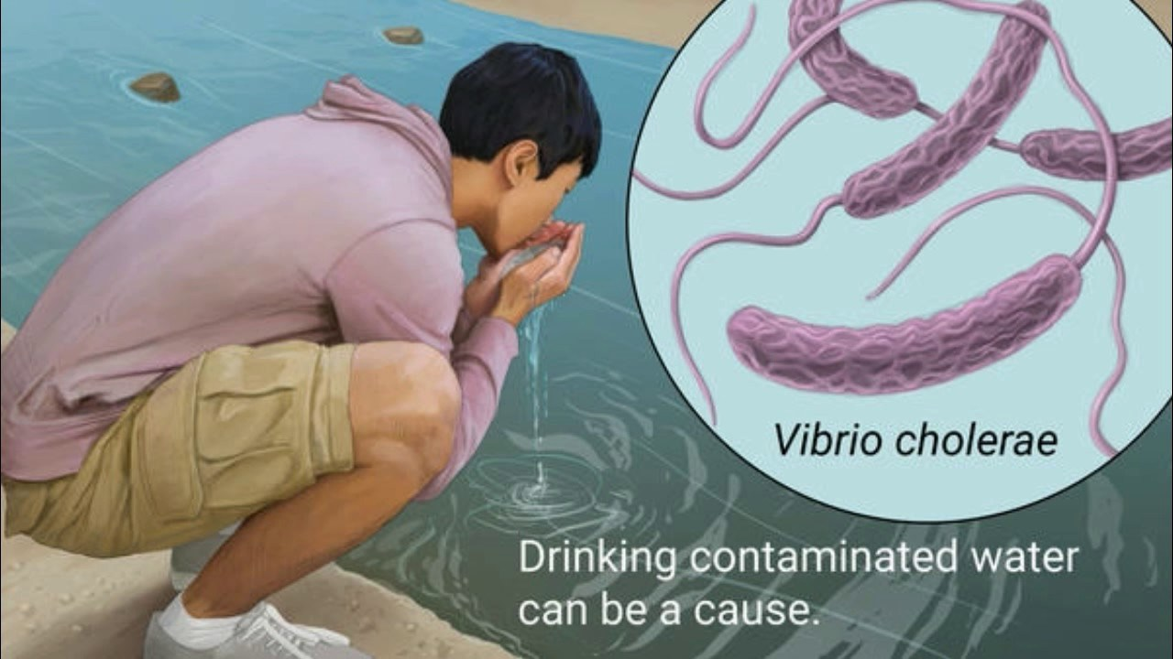
tuberculosis
cholera

Slide 8
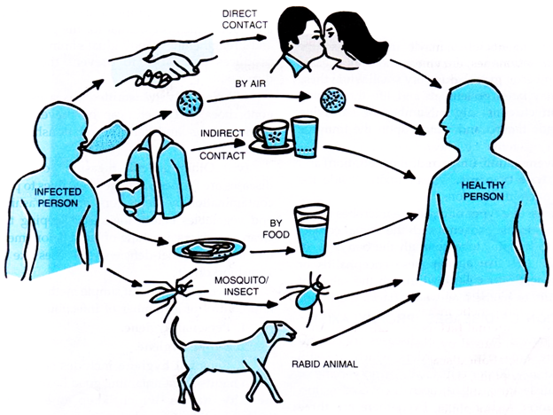
Way of transmission
Direct contact from person to person: physical contact like touching, kissing, body fluid exchange (blood, by sex), even sharing a towel/ shave in school
e.g. Sexually transmitted diseases (STDs)
e.g. Pregnant women can also transmit infectious diseases to their unborn children via the placenta or during childbirth.
(e.g. droplet sprays when sneezing counted as direct contact from various online resources)
https://courses.lumenlearning.com/microbiology/chapter/modes-of-disease-transmission/
https://media.nationalgeographic.org/assets/file/MethodsOfDiseaseTransmission.pdf
Notes:
https://www.cdc.gov/malaria/about/biology/index.html
Malaria is a serious and sometimes fatal disease caused by a parasite that commonly infects a certain type of mosquito which feeds on humans. People who get malaria are typically very sick with high fevers, shaking chills, and flu-like illness.
Because the malaria parasite is found in red blood cells of an infected person, malaria can also be transmitted through blood transfusion, organ transplant, or the shared use of needles or syringes contaminated with blood. Malaria may also be transmitted from a mother to her unborn infant before or during delivery (“congenital” malaria).
Antimalarial drugs taken for prophylaxis by travelers can delay the appearance of malaria symptoms by weeks or months, long after the traveler has left the malaria-endemic area.
The natural history of malaria involves cyclical infection of humans and female Anopheles mosquitoes. In humans, the parasites grow and multiply first in the liver cells and then in the red cells of the blood. In the blood, successive broods of parasites grow inside the red cells and destroy them, releasing daughter parasites (“merozoites”) that continue the cycle by invading other red cells.

Slide 9
Ways of transmission
2) Indirect contact from person to person:
a) By droplet (when talk, cough, sneeze): Since droplets fall to the ground within a few feet, this type of transmission requires close proximity.
b) Airborne (survive in air for a long time)
c) By contaminated surface (also called fomite, meaning inanimate object), such as a doorknob, elevator button, light switch, computer keyboard
d) By contaminated food or water
Fecal-oral
3) By vector (from insects, animals, e.g. mosquitos, tick, flea, raccoon, chicken)
Simple preventative measures, such as frequent hand washing, can cut down on disease transmission.
Notes:
Vectors are living organisms that can transmit infectious pathogens between humans, or from animals to humans. Often, once a vector becomes infectious, they are capable of transmitting the pathogen for the rest of their life during each subsequent bite/blood meal.
The term host is refers to those organisms or animals that harbors a pathogen, it means that the host will provide nutrients and shelter to the pathogen.

Slide 10
Body defences/ Immunity
Mechanical barriers
e.g. intact skin, blood clotting (when skin is cut), nasal hairs.
2) Chemical barriers
e.g. Mucosal lining (produce mucus), stomach acid (HCl),
3) WBCs/ Cells
Phagocytes, lymphocytes
The immune system is the body's natural defense mechanism whose function is to help fight infections.
But how does your body recognise when a foreign pathogen has entered?

Slide 11
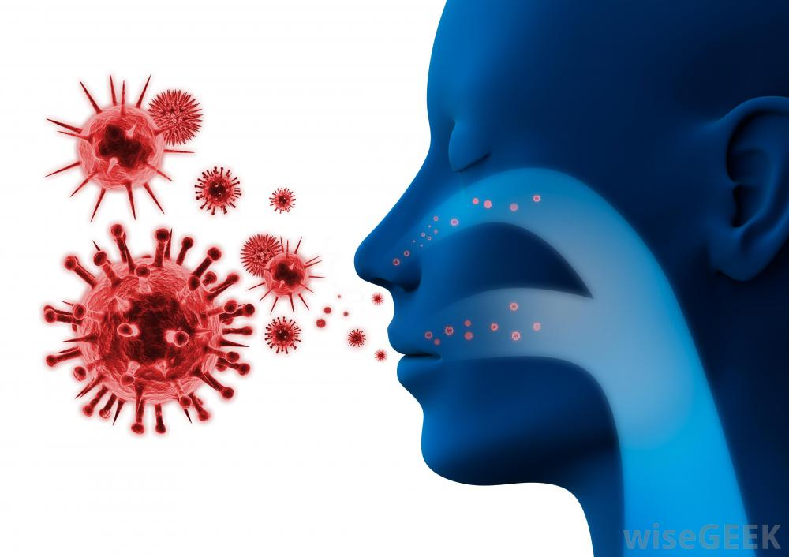
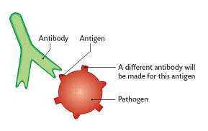
Body defences/ Immunity
Each antibody has a complementary shape to a specific type of antigen (which is a molecule on the surface of pathogen)

Slide 12
Body defences/ Immunity
The surface of every cell is covered with molecules that give it a unique set of characteristics. These molecules are called antigens. Antigens are generally fragments of protein or carbohydrate molecules.
The antigens on the surface of pathogenic cells are different from those on the surface of your own cells. This enables your immune system to distinguish pathogens from cells that are part of your body.
Do you have antigen molecules on your cells?
Immunity: being immune, avoid getting a certain infection.
https://www.abpischools.org.uk/topic/infectiousdiseases-immunity/2/1 animations

Slide 13
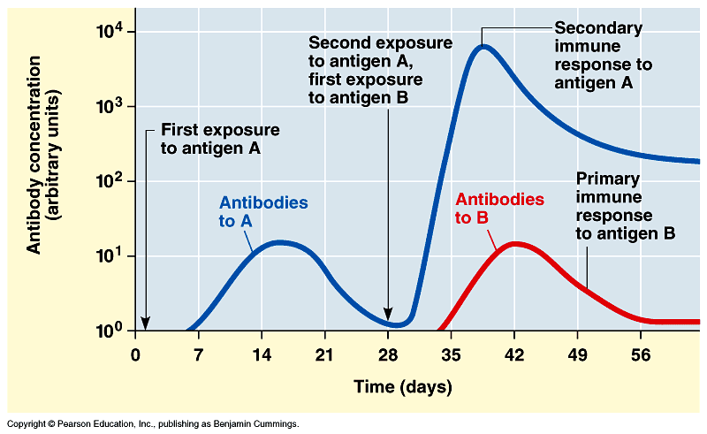
Immune response to infections

Slide 14
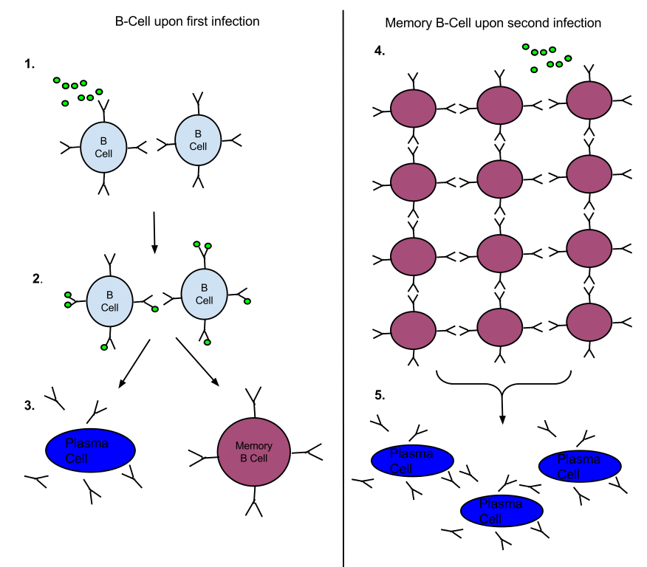
Immune response to infections – memory response
The lymphocyte makes clones of itself

Slide 15
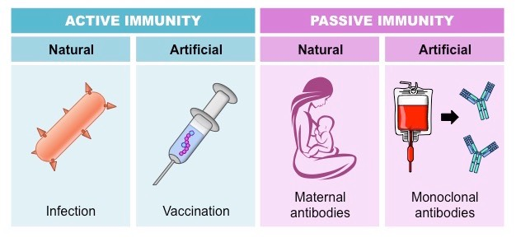
Active & Passive immunity
Active immunity – antibody (& memory cells) production in the body.
Passive immunity – acquire antibodies from another individual, giving short-term defence.

Slide 16
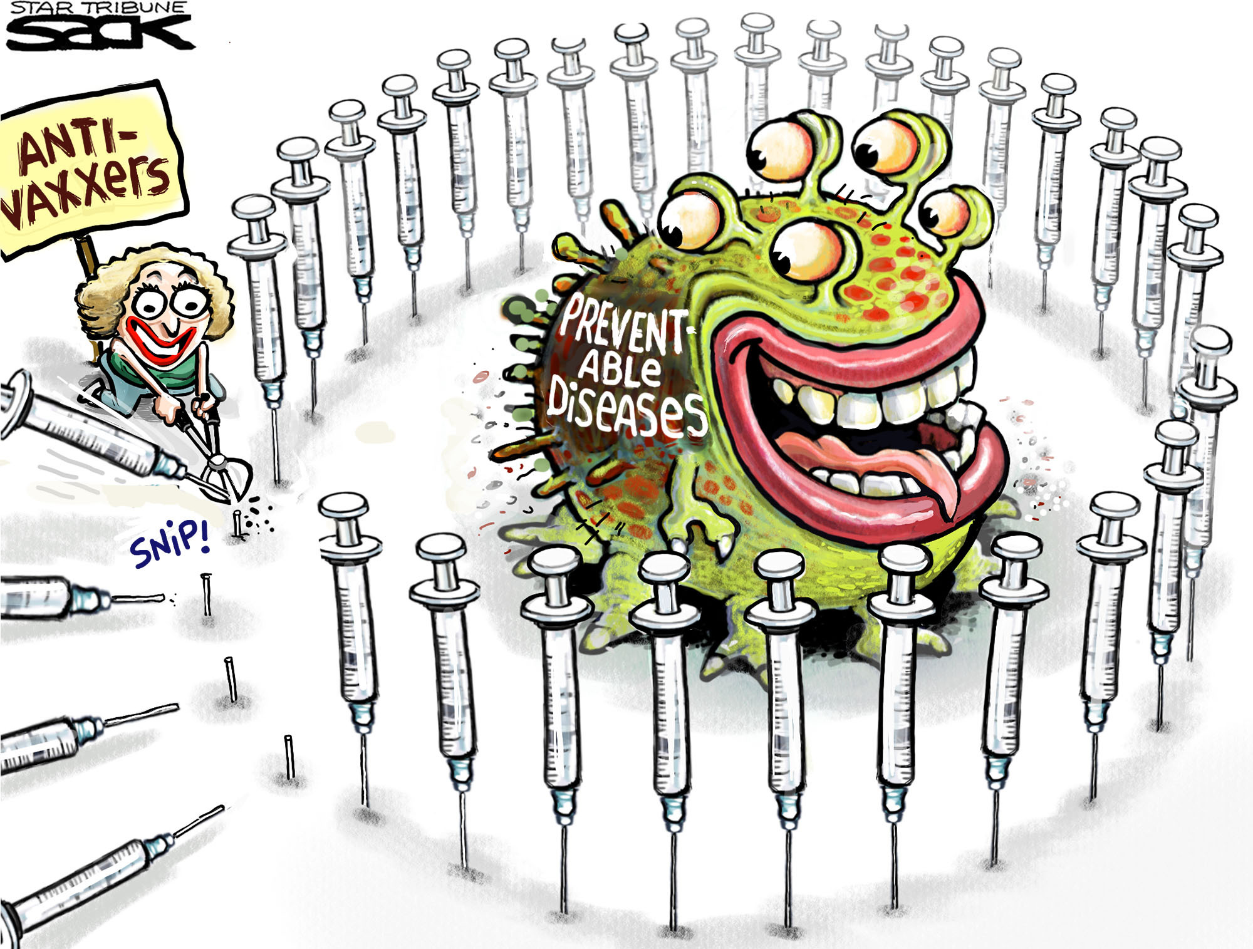
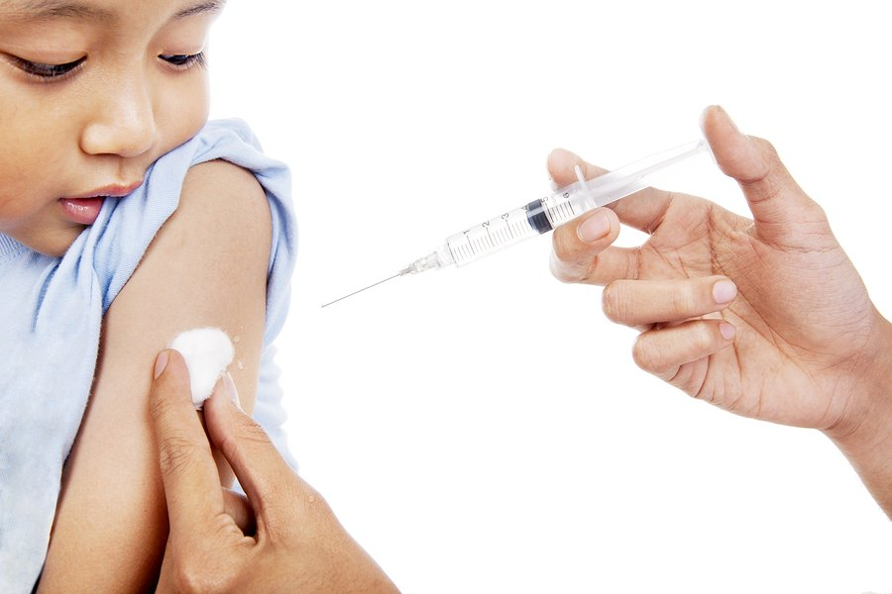
Vaccination
A small amount of dead or weakened pathogen is introduced into the body.
Vaccination enables the immune system to respond more quickly to future infection by that same live pathogen.

Slide 17

Vaccination
The first successful vaccine was against smallpox in 1796.
It was Dr. Edward Jenner who noticed that young women who milked cows usually caught cowpox, but rarely caught smallpox.
He thought maybe getting cowpox prevented getting smallpox.
To test his idea,
Dr. Jenner tried infecting people with cowpox on purpose, and then exposed them to smallpox. Amazingly, they didn’t catch smallpox.
He didn’t know exactly how it worked, but do you?
Dr. Edward Jenner - “THE FATHER OF IMMUNOLOGY”

Slide 18
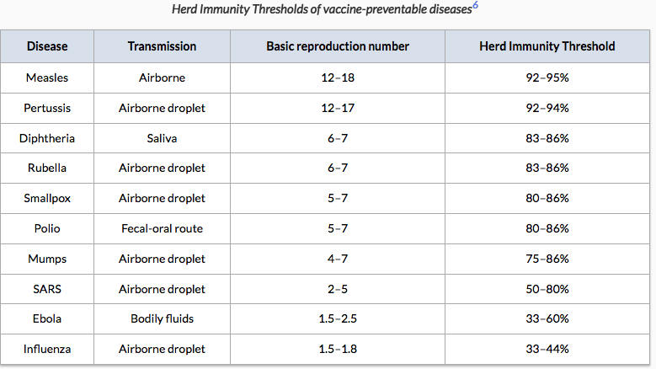
How vaccines work
There is a collective social benefit in a high vaccination coverage.
For most diseases, the greater the proportion of people who are immunized, the better protected is everyone in the population.
Because the disease transmission can be reduced or stopped.
Herd immunity is a community protection that is created when a high percentage of the population is vaccinated, such that it less likely that the infectious disease spreads.
Basic reproduction number: How many cases one infected person can generate
https://ourworldindata.org/vaccination#vaccines-save-lives

Slide 19

Control spread of transmissible diseases – cut down on transmission
1) Sanitation (the equipment and systems that keep places clean, especially by removing human waste)
A) Waste disposal
B) Sewage treatment
C) By using disinfectant such as 75% alcohol and chlorine disinfectant, alcohol-based hand sanitizer
2) Hygiene (the practice of keeping yourself and your living and working areas clean in order to prevent illness and disease)
A) Personal hygiene
B) Food hygiene
3) Vaccination

Slide 20
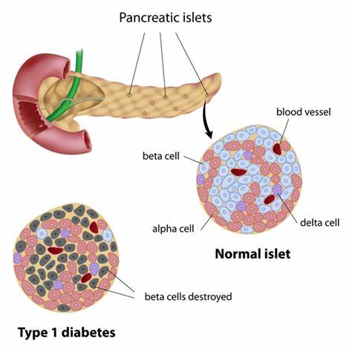
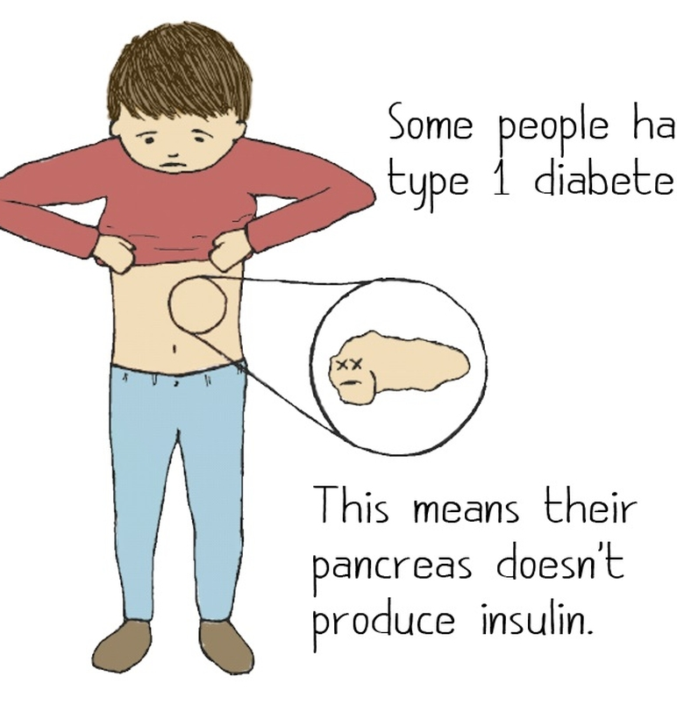
Auto-immune disease - Type I diabetes
- Affect Young children
Cause
- pancreas is attacked by immune system for unknown reason; cannot produce insulin
Symptoms
- blood glucose level fluctuates widely; frequent thirst, hunger, urination; weight loss;
Treatment
- inject insulin at regular intervals;
- diet restrictions
- monitor blood glucose frequently

